Slide 1
I am moving to California Which school should I enrol my kid so that he can get into the college of his choice?

Slide 2
List of URLs to the dataset
Average ACT Scores by State (Most Recent) (prepscholar.com)
act_2017.csv - 2017 ACT Scores By State
act_2018.csv- 2018 ACT Scores by State
act_2019.csv- 2019 ACT Scores by State
Here are the Average SAT Scores by State | CollegeVine Blog
sat_2017.csv - 2017 SAT Scores By State
sat_2018.csv- 2018 SAT Scores by State
sat_2019.csv- 2019 SAT Scores by State
DSI-SG-27/project_1 at master · dsi-sg/DSI-SG-27 (generalassemb.ly)
act_2019_ca.csv - 2019 ACT Scores in California by School
https://www.compassprep.com/college-profiles/
sat_act_by_college.csv - Ranges of Accepted ACT & SAT Student Scores by Colleges

Slide 3
Data Cleaning
act_2017.csv, act_2018.csv, act_2019.csv
Steps taken in data cleaning
Rename the columns
Change the data type of field “Participation” from Object to Float
Change the data type of field “Composite” from Object to Float
Remove the row “District of Columbia”
Remove the row in act_2017 for state=‘Wyoming’
Drop duplicate row “Maine”
Remove unnecessary column “English”, “Math”, “Reading”, “Science” from act_2017 dataset
Merge to a single dataframe
sat_2017.csv, sat_2018.csv, sat_2019.csv
Rename the columns
Change the data type of field “Participation” from Object to Float
Change the data type of field “Composite” from Object to Float
Remove the column ‘ebrw’ and ‘math’
Remove the row “Puerto Rico”, “Virgin Island”
Merge to a single dataframe

Slide 4
Data Cleaning
act_ca_score_2019.csv
Steps taken in data cleaning
Rename the columns
Remove unnecessary col “
Change the data type of field “"AvgScrRead”,” AvgScrEng”, “AvgScrMath”,” AvgScrSci” from Object to Float
Replace NA values with 0
Replace ‘*’ values with 0
Remove the row “District of Columbia”
Remove the row in act_2017 for state=‘Wyoming’
sat_act_by_college.csv
Rename the columns
Replace value “—” with 0
Remove the data row California Institute of Technology, Massachusetts Institute of Technology, Brown University, University of Chicago

Slide 5
Exploratory Data Analysis
ACT Scores across the states
North Dakota, Mississippi and Iowa has the lowest participation rate in 2017
District of Columbia, Delaware, Michigan and Connecticut has the highest participation rate in 2017
North Dakota has the lowest participation rate in 2018 Colorado,Connecticut, Delaware,
Michigan,Idaho has the highest participation rate in 2018
North Dakota has the lowest participation rate in 2019
Connecticut, Delaware, Michigan,Idaho,Illinois has the highest participation rate in 2019

Slide 6
Exploratory Data Analysis
SAT Scores across the states
District of Columbia, has the lowest SAT scores in 2017
Minnesota has the highest SAT scores in 2017
District of Columbia, has the lowest SAT scores in 2018
Minnesota has the highest SAT scores in 2018
West Virginia, has the lowest SAT scores in 2019
Minnesota has the highest SAT scores in 2019
Michigan, Connecticut, Delaware with 100% participation throughout 2017- 2019 District of Columbia, Colorado, Idaho has rate of change throughout 2017- 2019

Slide 7
Exploratory Data Analysis
Michigan, Connecticut, Delaware with 100% participation throughout 2017- 2019 District of Columbia, Colorado, Idaho has rate of change throughout 2017- 2019
West Virginia, South Carolina, Illinois, Hawaii, Georgia, Florida, Colorado have >50% participation on both test each year

Slide 8
Exploratory Data Analysis
Harvey Mudd College has the highest median SAT scores for admittance.
California State University--San Bernardino has the lowest median SAT scores for admittance
Harvey Mudd College, Vanderbilt University, Johns Hopkins University, Yale University, Carnegie Mellon University, Duke University, University of Pennsylvania, Rice University, Northwestern University, Harvard College has the highest median ACT Scores for admittance
California State University--San Bernardino has the lowest median ACT scores for admittance

Slide 9
Exploratory Data Analysis
Schools in California
Citrus High (Continuation) at Fontana Unified has the lowest mean scores
Lynbrook High at Fremont Union High has the highest mean scores

Slide 10
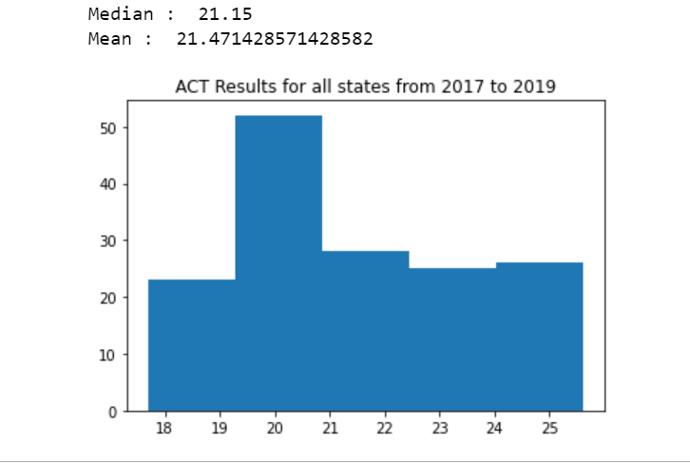
Histogram of ACT Results from all states between 2017 to 2019
Distribution is slightly positively skewed whereby mean (21.47)> median (21.15)

Slide 11
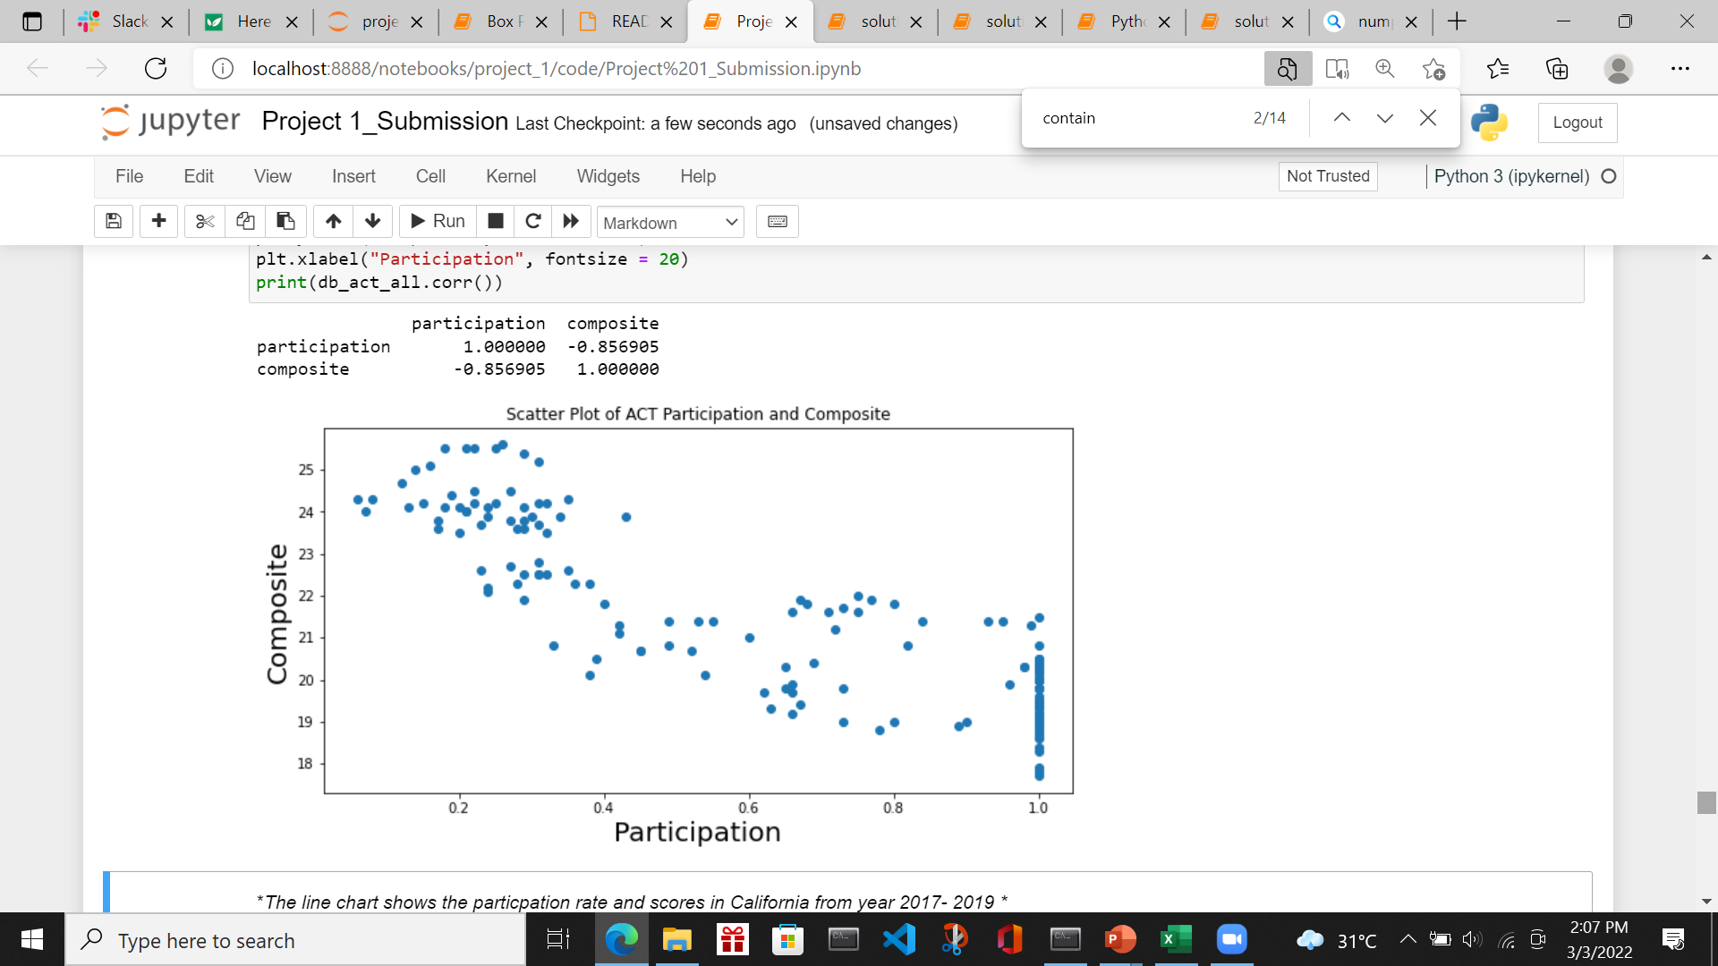
Histogram of ACT Results from all states between 2017 to 2019
There is a high negative relationship between composite and participation forecast.

Slide 12
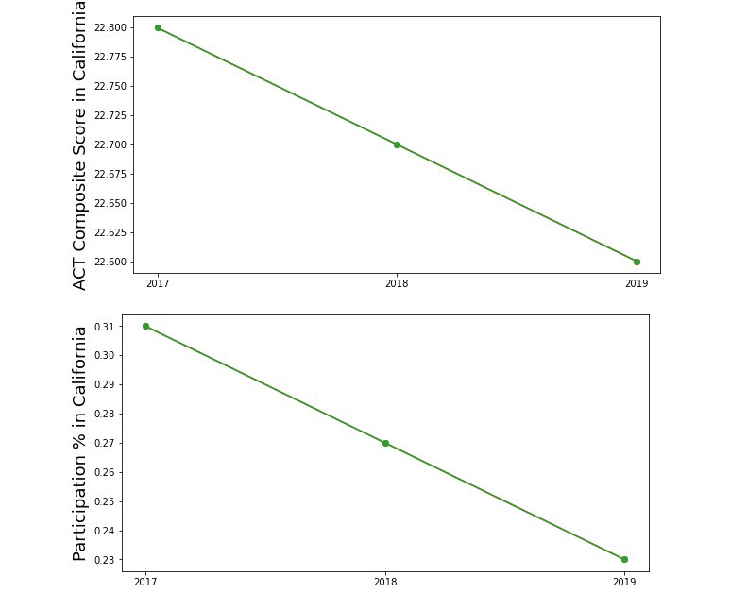
Line Chart on ACT participation and Results in California
There is slight drop in the ACT participation and scores in California.

Slide 13
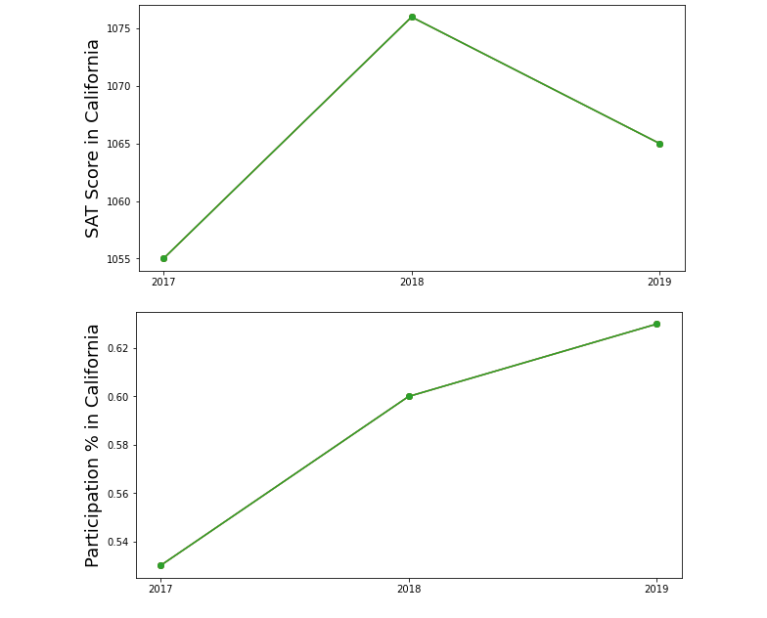
SAT Scores in California
In 2019, there is a drop in SAT Scores in California
The adoption of SAT is increasing in California

Slide 14
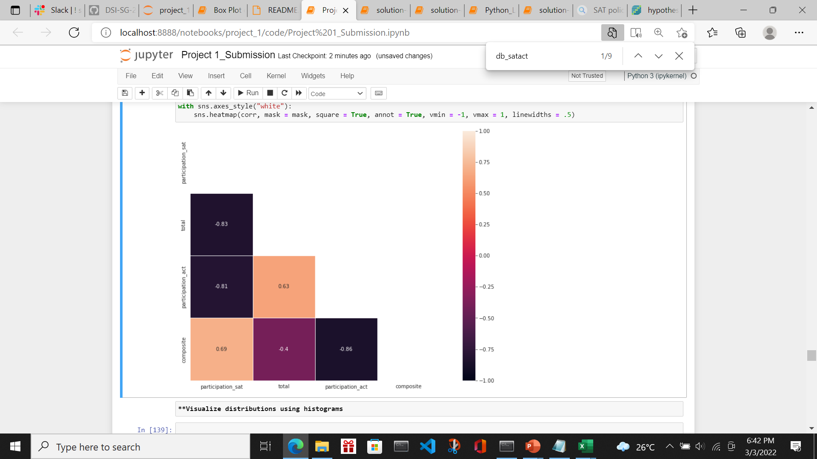
Correlation between SAT and ACT participation
There is high negative correlation between SAT and ACT participation
Which explains why the earlier slide showing a declining in participation in ACT yet result in increasing participation in SAT

Slide 15
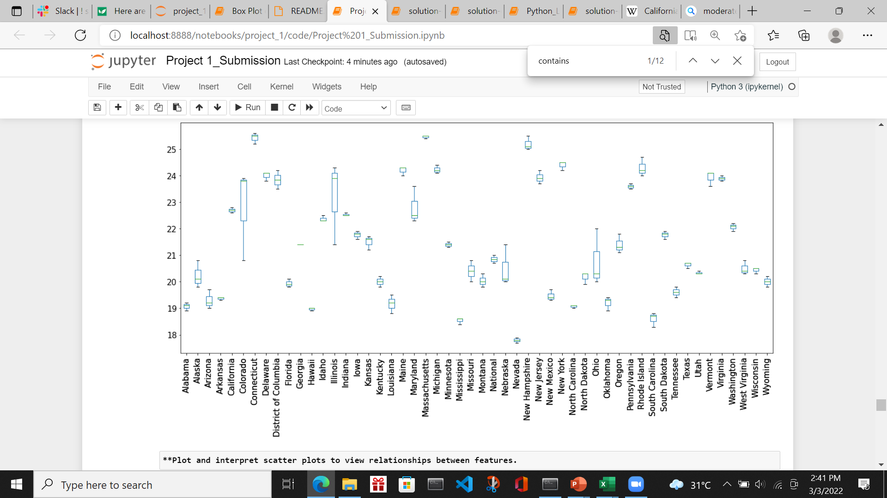
ACT scores across all the state between 2017 to 2019
The side-by-side boxplots little overlap
The spread for average ACT scores is narrow which is between 22.5 and 22.8

Slide 16
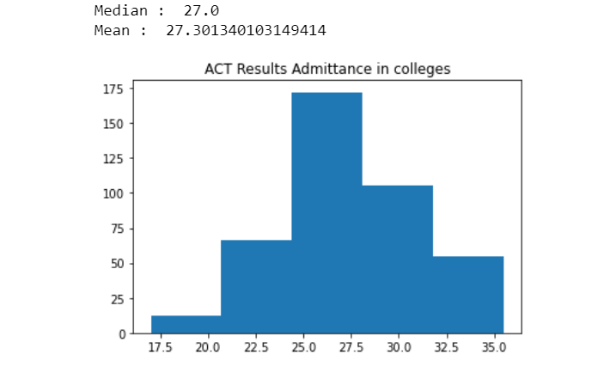
ACT scores admittance across colleges
Distribution is slightly positively skewed whereby mean (27.3)> median (27)
If using the average result in Calfornia, schools having the ACT admittance scores are limited.
So, it is important to select the better schools in California so that the probability of getting the desired score is high

Slide 17
Conclusion
Overall, the average scores in California is around 22.7 which is considerably low.
The better universities has a requirement of a median scores of at least 34
In California, school with highest ACT average score of around 31.75 is Lynbrook High at Fremont Union High
I will consider to enroll my son to schools that has average scores of minimally 31 and above

